Slide 1
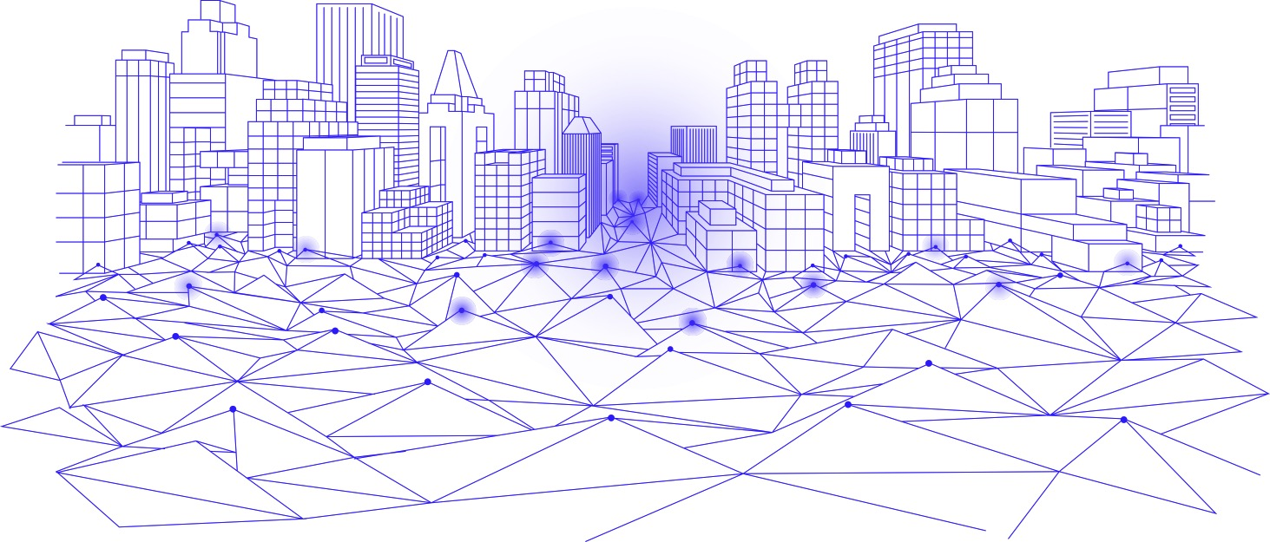

The Future is Serverless
Saman A. Pour

Slide 2
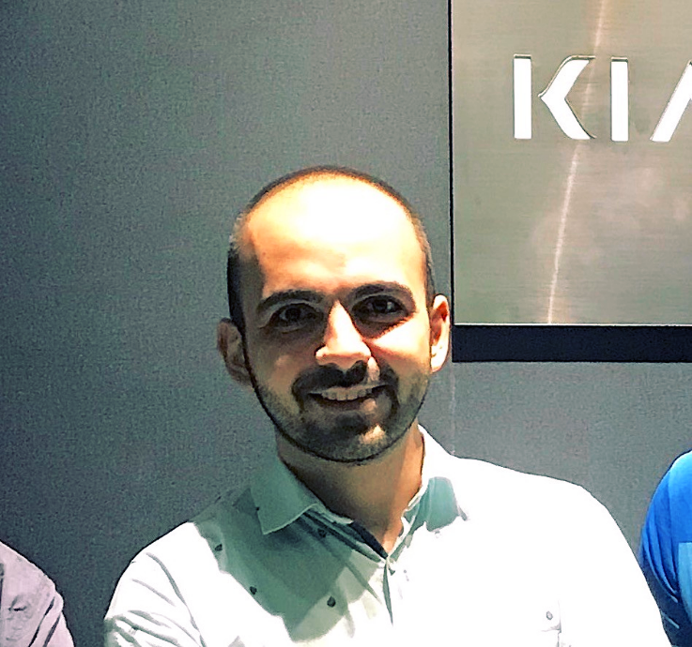
About Me
Lead Software Engineer @ Knockri
Masters in Information Technology
CFA level 1 & CSC
Produce podcasts
Write articles
Give talks
Hiking
Cycling
Cooking
Kayaking (new)

Slide 3
The Talk Structure
Introduce Case Study
Architecture History (100B.C. - 2019)
Challenges of Serverless
Live Demo
Use the demo we created together

Slide 4
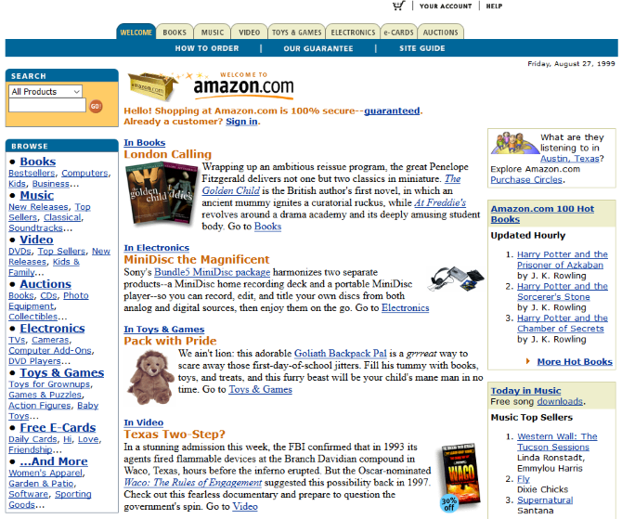

Case Study
1999

Slide 5

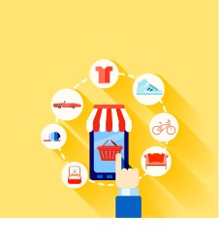

System Description

Slide 6
Architecture History

Slide 7
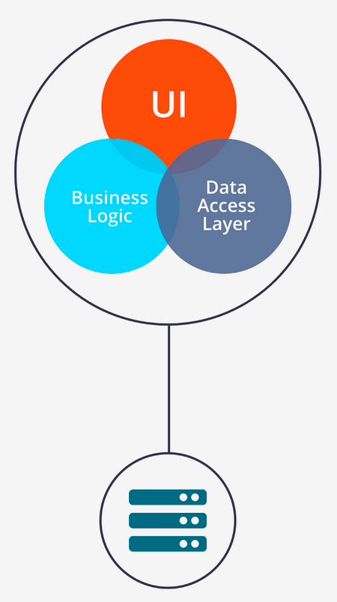
Monoliths
A big chunk of code
Composed of different components
All-in-one software app

Slide 8
Monolith Arch Benefits
Easy to build
Easy to test
Easy to deploy
Perfect for small loads
Perfect for startups at MVP level
Simple to scale horizontally

Slide 9
Monolith Arch Drawbacks
Maintenance – Too large
Slow startup time – Because of the size
Redeploy application for each update
Lower reliability – One bug brings down all
Very hard to adopt and evolve

Slide 10
Service Oriented Architecture (SOA) Guiding Design Principles
A service has the following properties:
It logically represents a business activity with a specified outcome.
It is self-contained.
It is a black box for its consumers.
It may consist of other underlying services.

Slide 11




Case Study: Monolith -> SOA
User

Slide 12
SOA Criticism
At the time that we didn’t have cloud:
- Separate infrastructure for each service (Huge upfront investment)
Networking required (switch, router, cables, …)
Very good developers needed for RPC, Sys Availability
Developers / Operation people needed

Slide 13
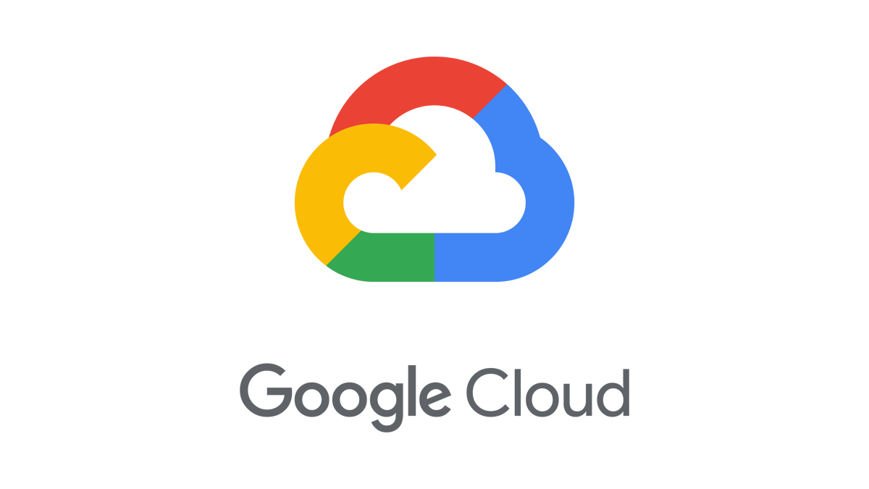




Cloud Computing
On-Demand
relies on sharing of resources for economics of scale
2006 – Amazon EC2
2008 – Google App Engine
2010 – Azure
2011 - IBM
Notes:
What was the first service provided by cloud vendors?

Slide 14
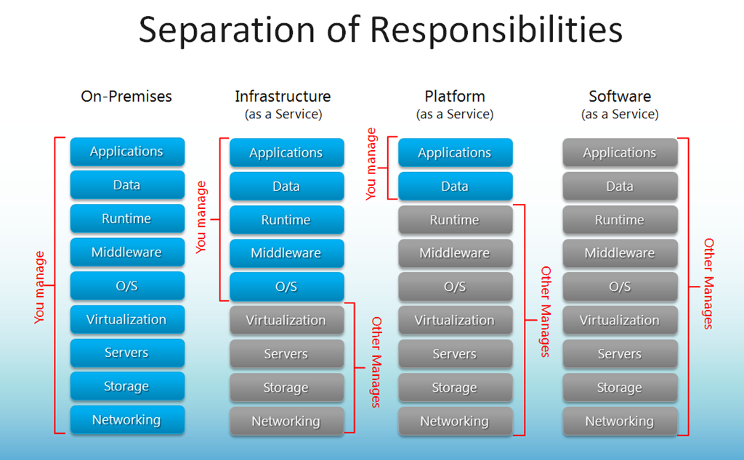

Slide 15
SOA -> CLOUD
User

Slide 16


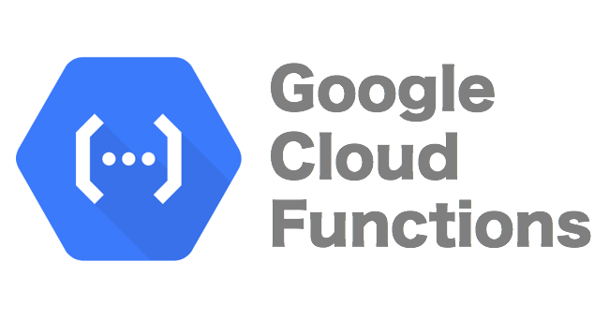
Serverless
Function As a Service (FaaS)
No Server Management
No Heavy Frameworks (Django, Flask,…)
Applications -> Small Functions
Functions Scaled Individually

Slide 17
Design Constraints
Serverless apps are a bit slower
Good with the apps with simple functionalities
They need a warm-up time
Notes:
Slowness give a bad client experience

Slide 18
CLOUD -> SERVERLESS
User

Slide 19
Cloud -> Serverless

Slide 20
Serverless Benefits
The program is easier to debug
Easier to deploy (one command deploy)
Inherent Elasticity
Devs can focus on “business logic” code
Pay as usage
First 1,000,000 request for free (good for startups)

Slide 21
Serverless Challenges
Warm up time
Generally slower
Can’t well tune the underlying structure
Not very mature (many options are not well written)
Changing everyday as matures
Privacy/Security
!!! Vendor Lock-in

Slide 22

LIVE DEMO

